Slide 1


Airline Safety & Public Perception
http://clipart-library.com/airplane-cliparts.html
Maddie Bauer
DSC 640

Slide 2
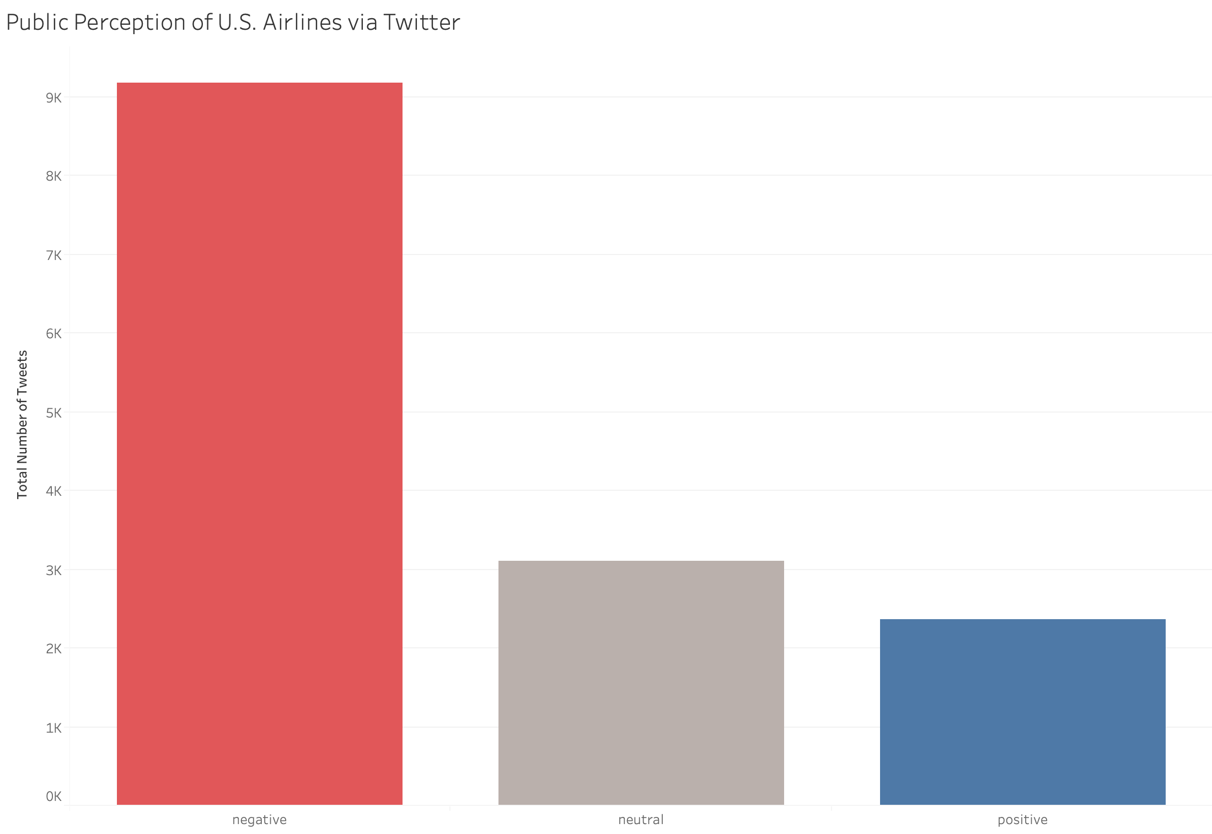
In 2015, over 9,000 negative tweets were posted in relation to airlines in the United States.
*Negative tweets included topics such as safety, trouble booking, canceled/delayed flights, etc.
Notes:
Airlines typically do not have the best reputation. In 2015 alone, over 9,000 negative tweets were posted online in regard to 5 airlines within the United States. How can we change this negative reputation? Let’s take a deeper look at safety concerns.

Slide 3
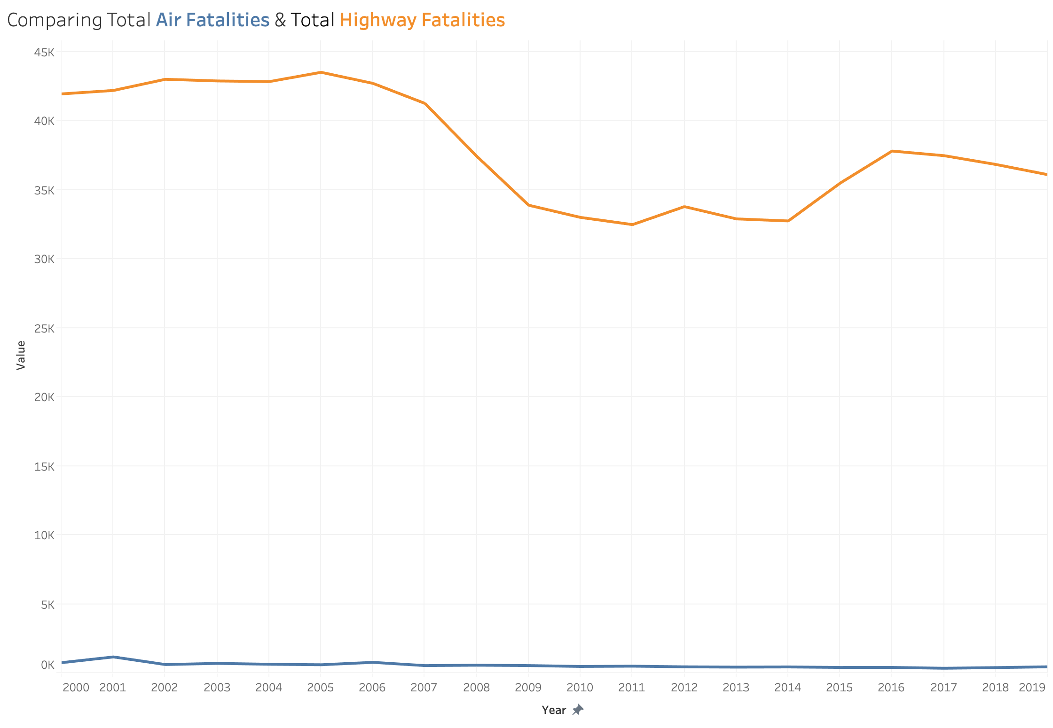
The number of air fatalities is far lower than the number of highway fatalities for every given year.
Notes:
Here we’re comparing highway fatalities to air travel fatalities. Clearly, the number of air fatalities is far lower that the number of highway fatalities for every given year. Customers can feel confident when booking flights that air travel is safe. This should help with public perception.

Slide 4
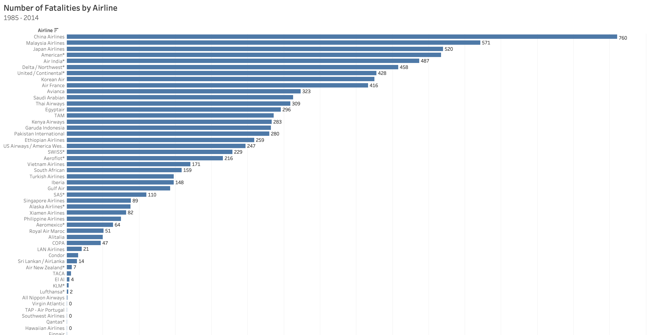
The top 3 leading airlines are NOT domestic airlines in the U.S.

Slide 5
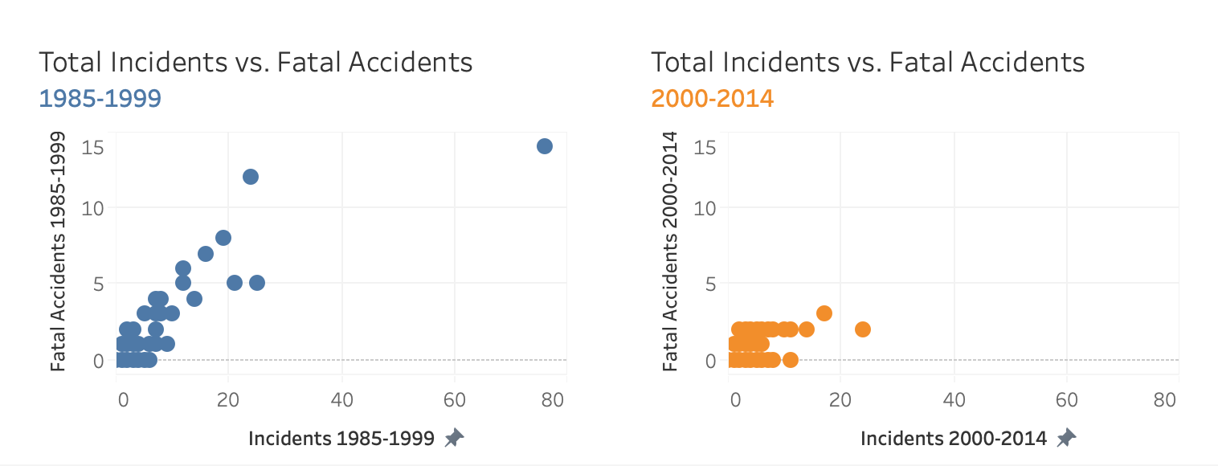
It is evident that both the number of airline incidents and the number of fatal accidents are decreasing over the recent years.

Slide 6
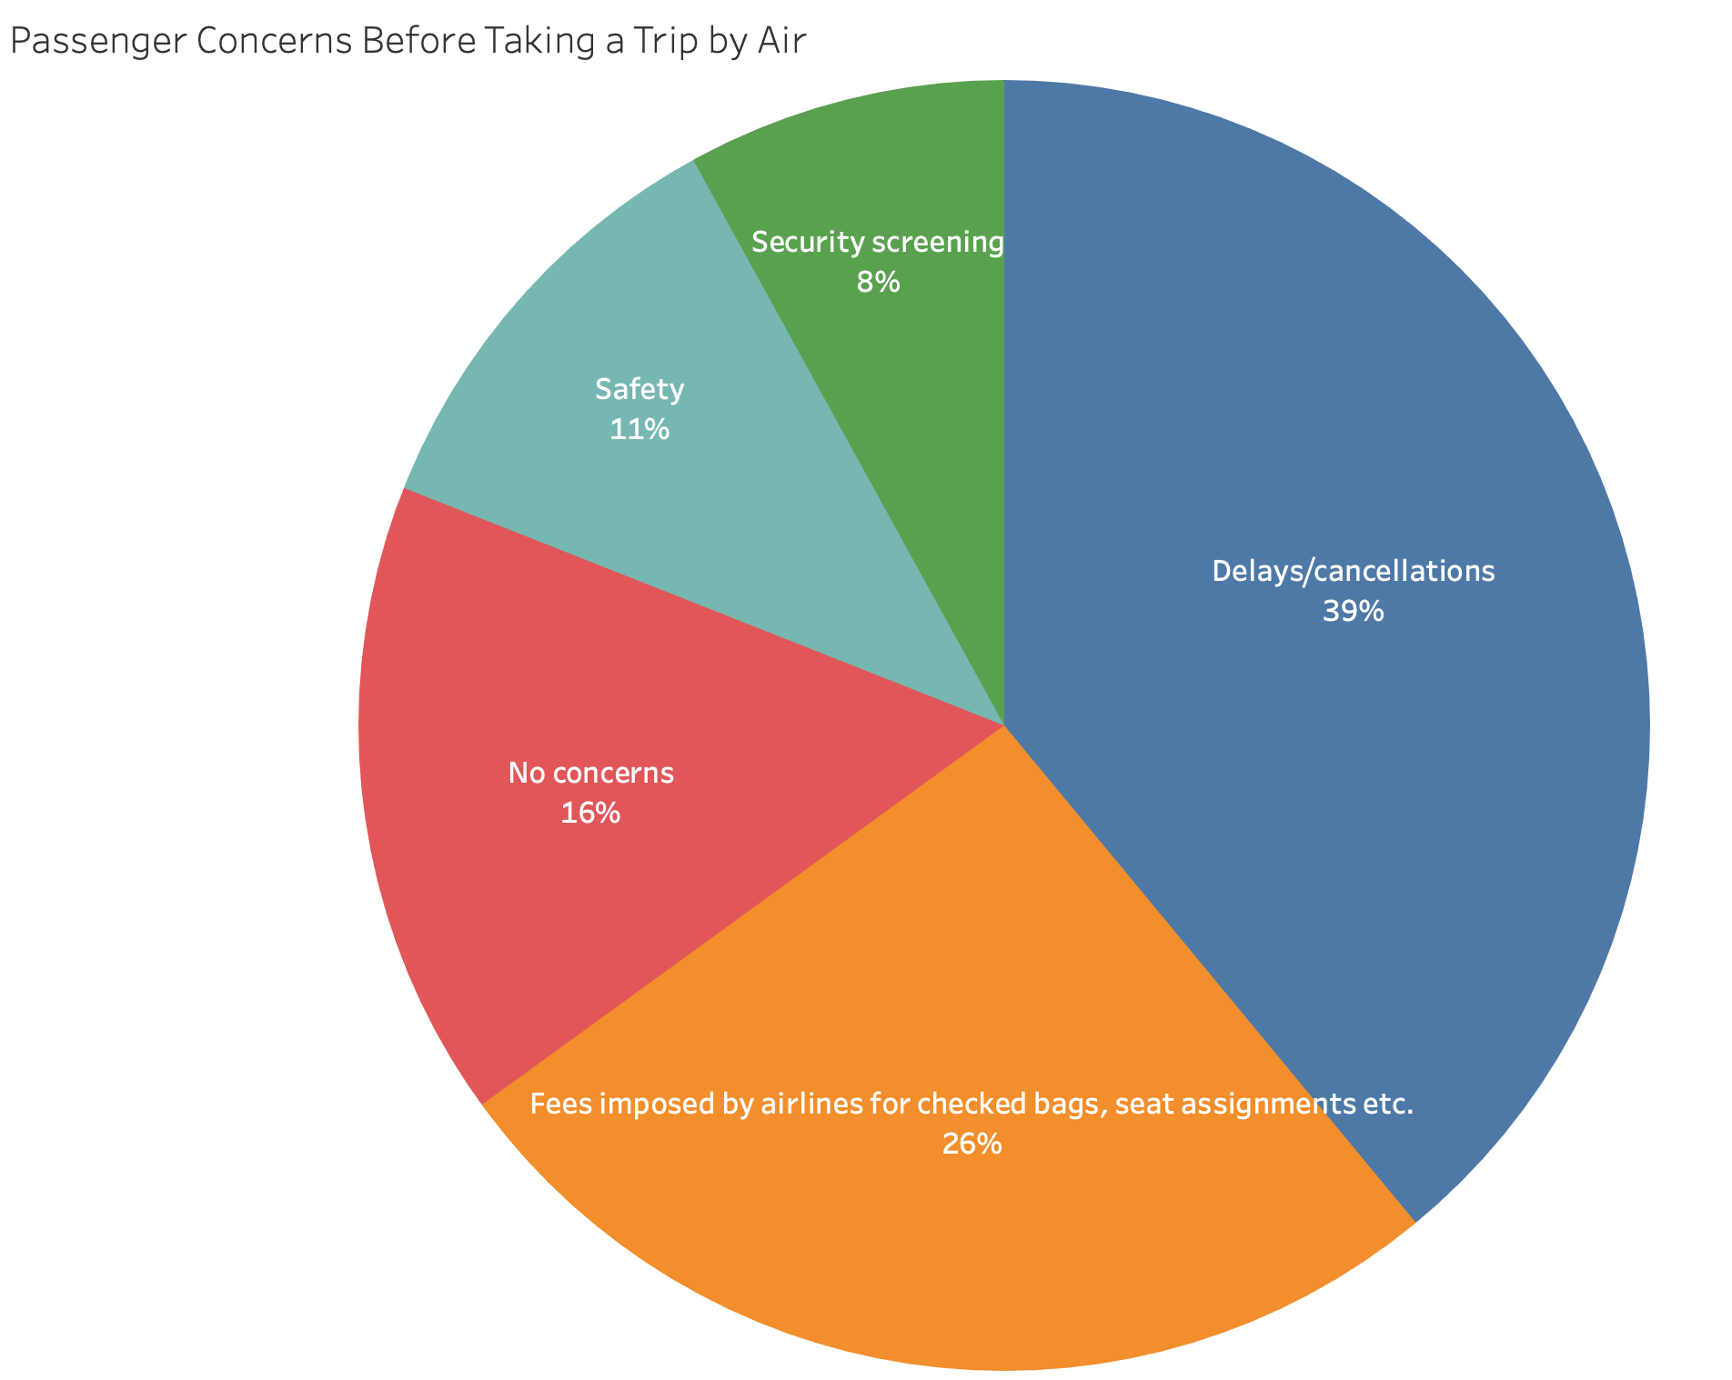
(2014)
Safety accounts for only 11% of passenger concerns prior to taking a flight.

Slide 7
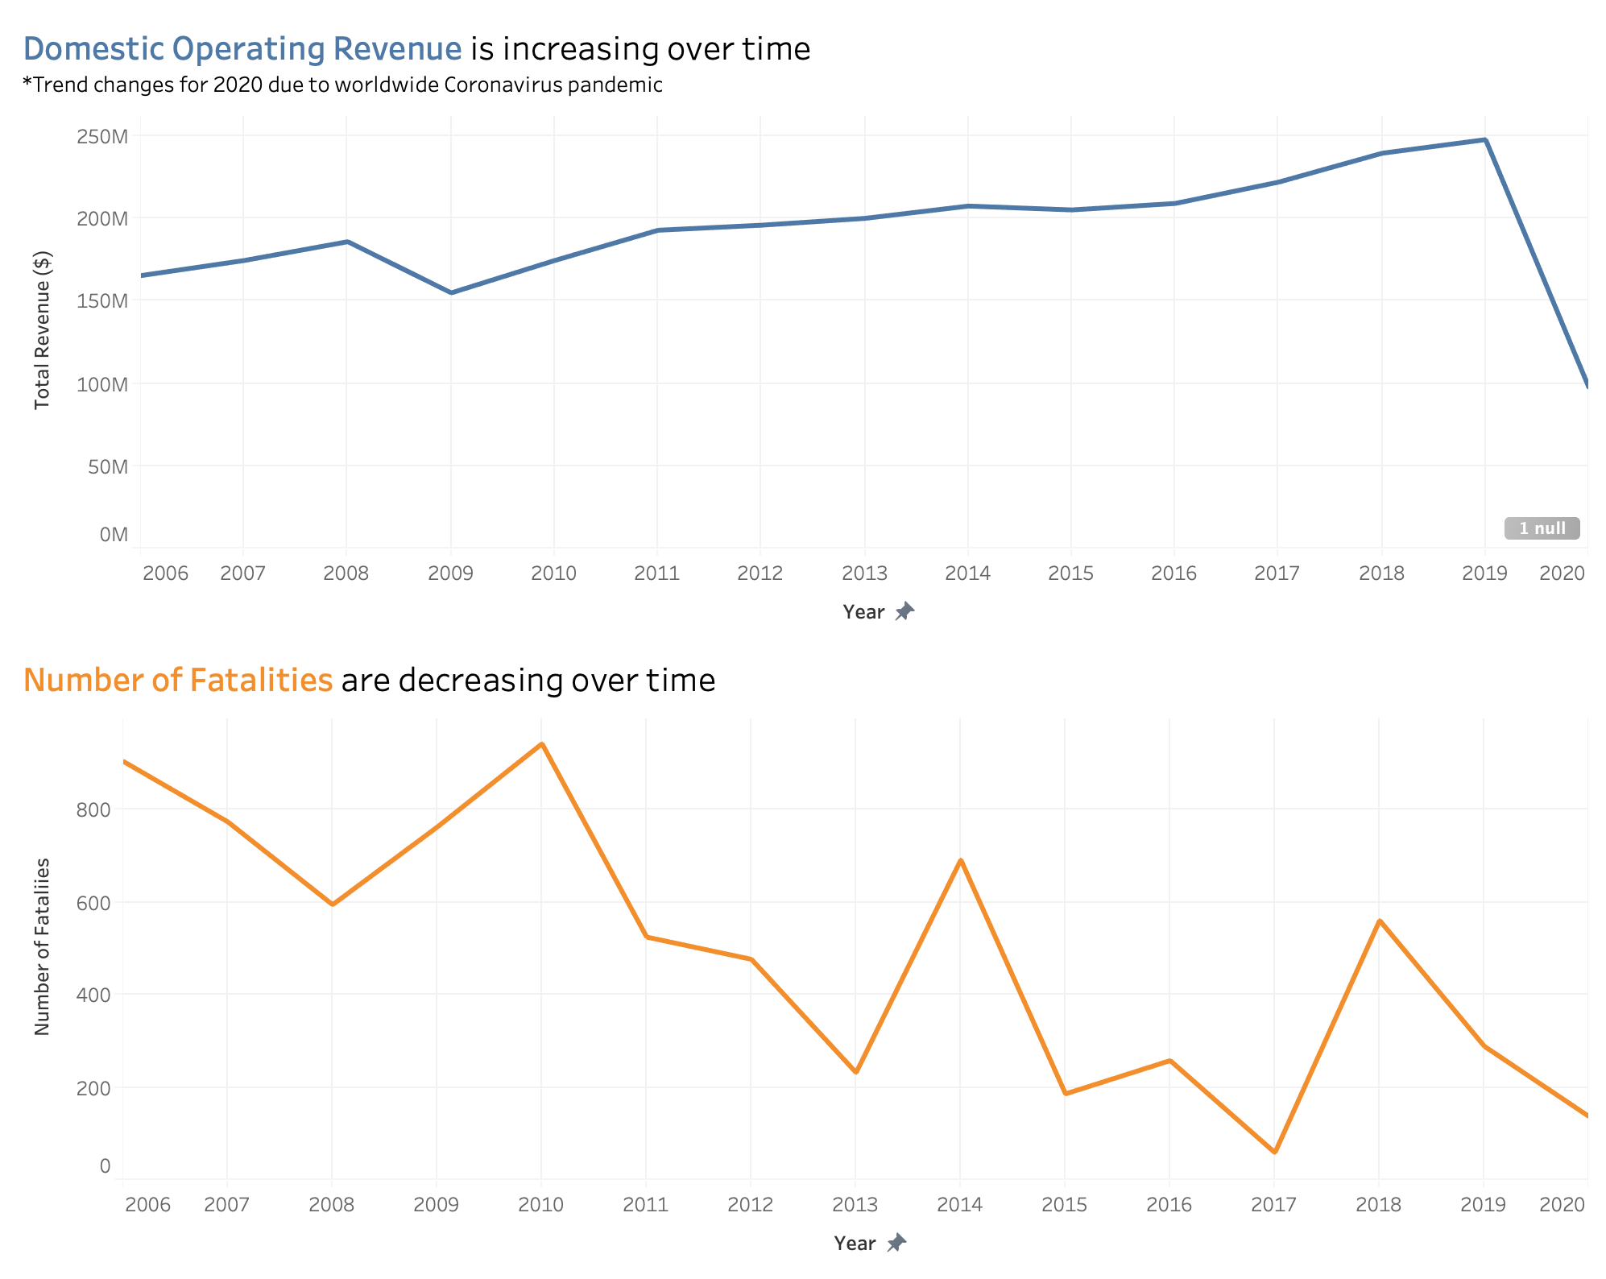
As the number of fatalities decrease with time, revenue continues to climb.

Slide 8
Conclusion & Next Steps
Air travel is safe!
Safety is NOT the most pressing concern by passengers before taking flight
The public must be changing their perception as revenue continues to increase over time
-------------------------------------------------------------------------------------------------------------
Continue informing the public that air travel is safe
Blog Posts
Short Ads for TV & Social Media
Infographics
Notes:
In conclusion, we can continue pushing this trend to the public as the data reflects that air travel is in fact safe. While there may be public chatter relating to air travel safety, we also know that it’s not the most common concern that passengers have prior to taking flight. Public perception may be slowly changing already so we should continue to push out blog posts, ads and infographics to the public that share our message.

Slide 9
Resources
Total Airline Fatalities and Highway Fatalities Dataset
https://www.bts.gov/content/transportation-fatalities-mode
Airline Safety Dataset
https://github.com/fivethirtyeight/data/tree/master/airline-safety
Operating Revenue Dataset:
https://www.transtats.bts.gov/Data_Elements_Financial.aspx?Qn6n=K
Passenger Concerns Dataset
https://www.statista.com/statistics/306872/most-common-concerns-of-air-travelers-us/
Worldwide airline fatalities Dataset:
https://www.statista.com/statistics/263443/worldwide-air-traffic-fatalities/
Twitter Sentiment Analysis Dataset:
https://www.kaggle.com/crowdflower/twitter-airline-sentiment

